Slide 1
Chapter 10
Basic Network Design

Slide 2
Object
• Determine factors that affect network design
• Implement guidelines for installing cable
• Use structured wiring and networking in your network designs
• Design a network for a home
• Design a network for an office or organization
http://fpt.edu.vn

Slide 3
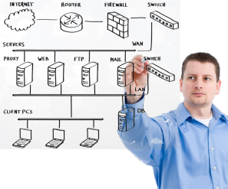
Factors that Affect a Network Design
Planning should precede equipment purchase
Nine factors to consider
  Purpose of the network
  Anticipated network traffic
  Redundancy requirements
  User movement
  Future growth
  Security considerations
  WAN connectivity
  LAN and WAN costs
  Existing network topology and resources
http://fpt.edu.vn

Slide 4
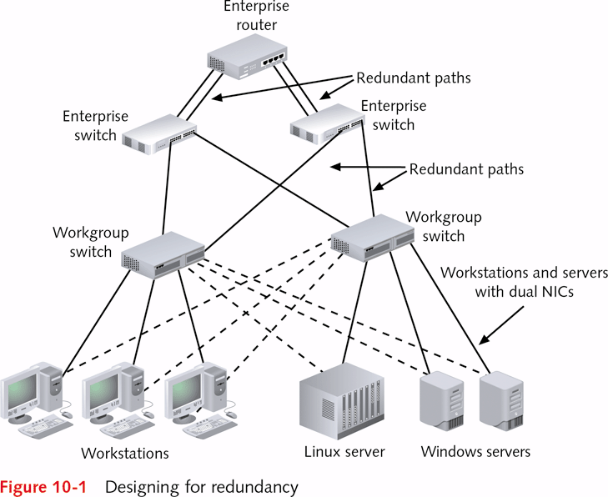
http://fpt.edu.vn

Slide 5
Future Growth
Successful networks have growth potential
Scalable networks extend original investment
Several ways to accommodate growth
  Select 100BaseTX network if goal is 1000BaseTX
    Converts to 1000BaseTX better than 16 Mbps token ring
  Design networks around modern routers and switches
    Avoid use of older devices, such as bridges and hubs
  Install cable of Category 5e or better in cable network
  Employ standardized technology in wireless networks
    Example: use 802.11 devices without proprietary add-ons
http://fpt.edu.vn

Slide 6

Security Considerations
Security vital in office and home networks
Levels of protection vary with network
Examples of security level need by company type
  High: payroll-processing company
  Moderate: provider of a public database of health statistics
http://fpt.edu.vn

Slide 7
WAN Connectivity
Varies with design of LANs
Consider how LAN and WAN will interoperate
Basic WAN connectivity need
  LAN requires DSL or ISDN lines to connect to Internet
Complex WAN connectivity based on various needs
  Satellite communications for overseas connections
  Frame relay to join LANs in neighboring states
  T-3 lines for universal access to a Web site used to market products
http://fpt.edu.vn

Slide 8
LAN and WAN Costs
Important factors in any LAN or WAN project
Are constrained by budget or specific allocation
Are projected using itemized list
  Communications cable (for a cabled network)
  Network devices
  Additional computers and printers required for network
  Network management/analysis software and hardware
  Installation
  Training
  Vendor consulting
  WAN service or leasing fees
http://fpt.edu.vn

Slide 9
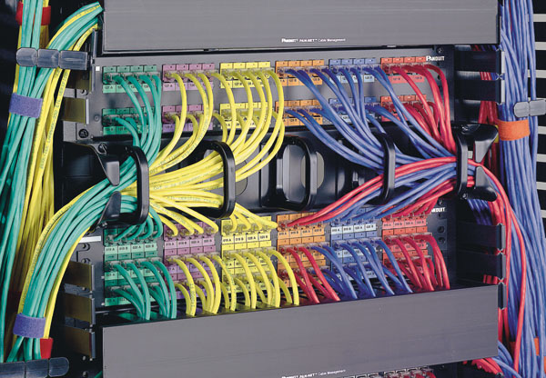
Using Structured Wiring
Cable fans out as horizontal star from central location
Details of central location
  May be telecommunications room or wiring closet
  Contains one or more switches or routers
Requirements of structured wiring
  Flexible cabling, such as twisted pair
  Wiring nodes into a physical star
  Adherence to standards for horizontal wiring
    Defined by EIA/TIA-568-A or EIA/TIA-568-B
  Centralizing the cable plant in switches or routers
http://fpt.edu.vn

Slide 10
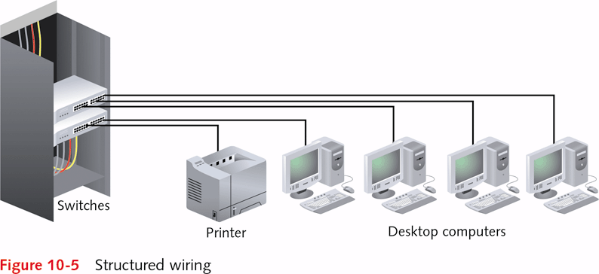
http://fpt.edu.vn

Slide 11
Using Vertical Wiring and Structured Networking
Vertical wiring (riser cable)
  Cabling and network equipment used between floors
  Ties horizontal cables on floors to form logical backbone
Principles to follow
  Deploy an extended star topology between devices
    Daisy-chain wiring closets between floors
    Use with redundant backplanes and power supplies
  Use high-speed cable (multimode fiber-optic cable)
    Not susceptible to EMI and RFI
    Reduces congestion on backbone
  Adhere to standards for vertical or backbone cabling
    Follow EIA/TIA-568-A or EIA/TIA-568-B
http://fpt.edu.vn

Slide 12
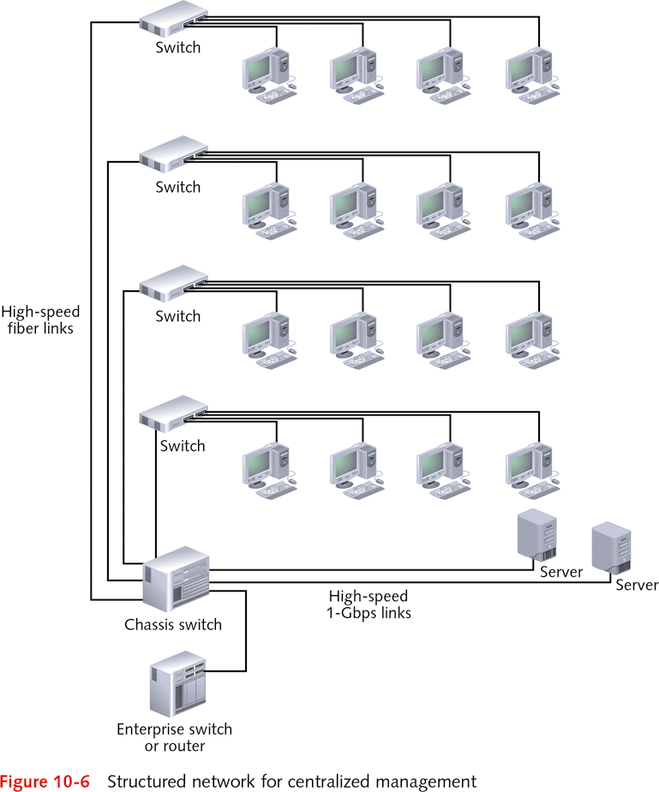
http://fpt.edu.vn

Slide 13
Building Block Network Design
While some organizations still use the traditional approach, many others use a simpler approach to network design, the building block approach.
This approach involves three phases: needs analysis, technology design, and cost assessment.
The process of cycling through all three design phases is repeated until a final design is decided on.
http://fpt.edu.vn

Slide 14
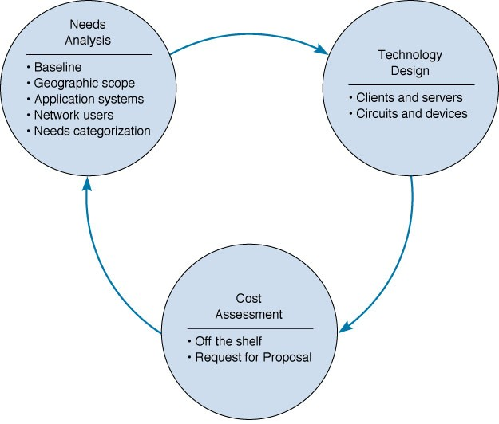
Building Block Network Design
http://fpt.edu.vn

Slide 15
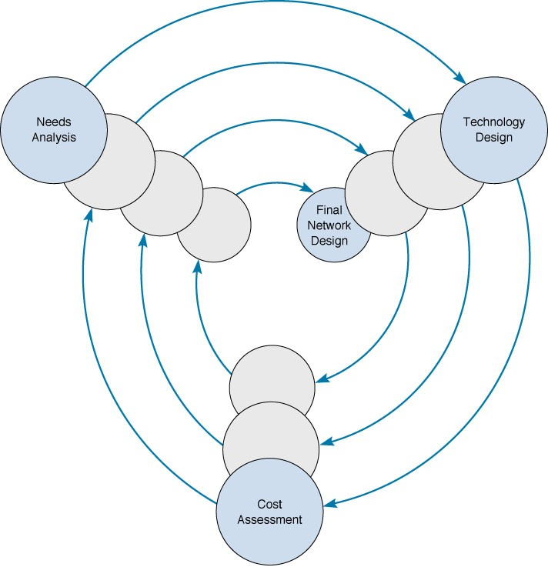
Reaching a Final Network Design
http://fpt.edu.vn

Slide 16
Needs Analysis
The first step is to analyze the needs of network users along with the requirements of network applications.
LAN design issues include improving performance, upgrading or replacing unreliable or aging equipment, or standardizing network components to simplify network management.
At the MAN/WAN level, circuits are leased and upgrades involve determining if capacity increases are needed.
The object of needs analysis is to produce a logical network design, which describes what network elements will be needed to meet the organization’s needs.
http://fpt.edu.vn

Slide 17
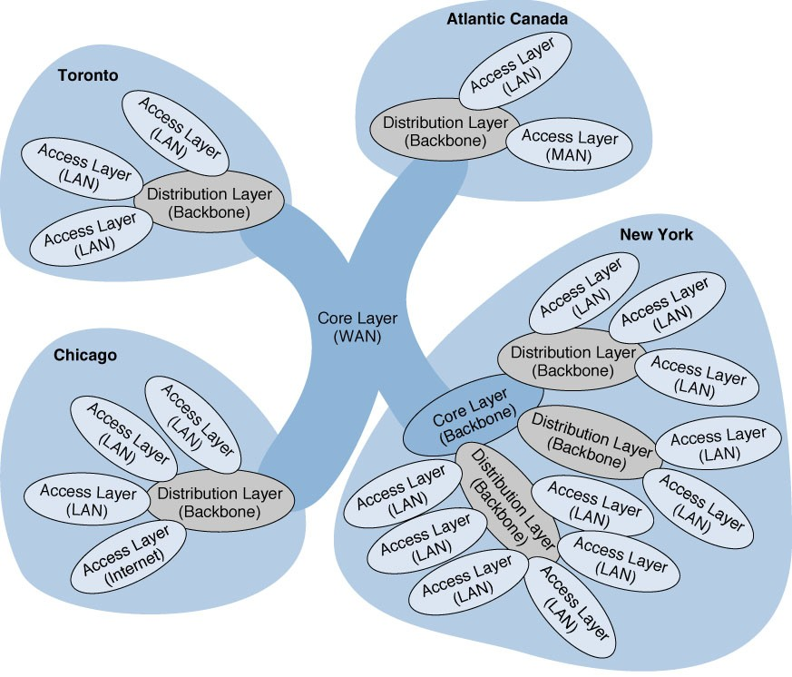
Geographic Scope
http://fpt.edu.vn

Slide 18
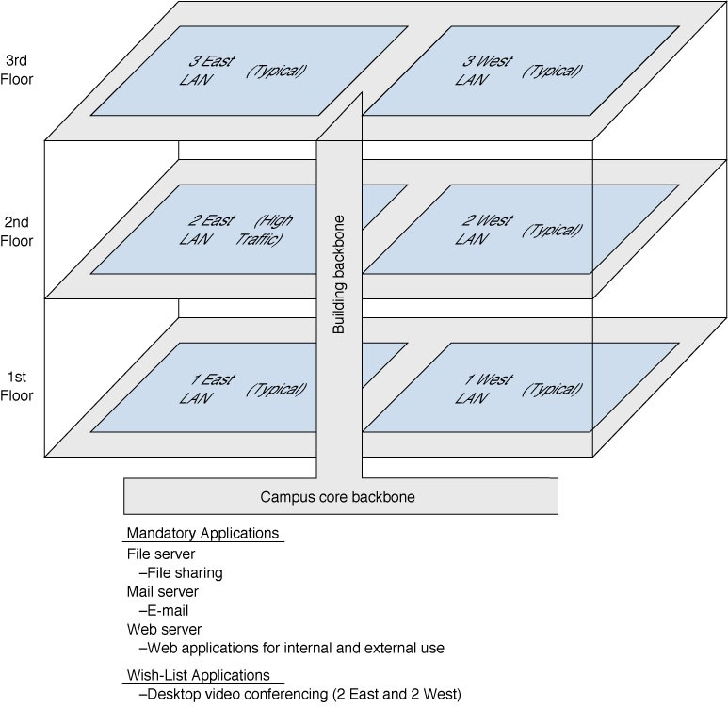
Logical Network Design
http://fpt.edu.vn

Slide 19
Designing Circuits and Devices
Two inter-related decisions in designing network circuits and devices are:
  Deciding on the fundamental technology and protocols
  Choosing the capacity each circuit will operate at
Capacity planning means estimating the size and type of the “standard” and “advanced” network circuits for each type of network.
This requires some assessment of the current and future circuit loading in terms of average vs. peak circuit traffic.
http://fpt.edu.vn

Slide 20
Network Design Tools
Some modeling tools require the user to create the network map from scratch. Other tools can “discover” the existing network.
Once the map is complete, the next step is to add information about the expected network traffic and see if the network can support the level of traffic that is expected. This may be accomplished through simulation models.
Once simulation is complete, the user can examine the results to see the estimated response times and throughput.
http://fpt.edu.vn

Slide 21
Cost Assessment
To assess the costs of various network alternatives produced as part of technology design. Costs to consider include:
  Circuit costs for both leased circuits and cabling.
  Internetworking devices such as switches and routers.
  Hardware costs including servers, memory, & NICs.
  Software costs for operating systems, application software and middleware.
  Network management costs including special hardware, software, and training.
  Test and maintenance costs for monitoring equipment and supporting onsite repairs.
  Operations costs to run the network.
http://fpt.edu.vn

Slide 22
Request for Proposal
Background Information
  Organizational profile; Overview of current network; Overview of new network; Goals of the new network
Network Requirements
  Choice sets of possible network designs (hardware, software, circuits); Mandatory, desirable, and wish list items, Security and control requirements; Response time requirements; Guidelines for proposing new network designs
Service Requirements
  Implementation time plan; Training courses and materials; Support services (e.g., spare parts on site); Reliability and performance guarantees
Bidding Process
  Time schedule for the bidding process; Ground rules; Bid evaluation criteria; Availability of additional information
Information Required from Vendor
  Vendor corporate profile; Experience with similar networks; Hardware and software benchmarks; Reference list
http://fpt.edu.vn

Slide 23
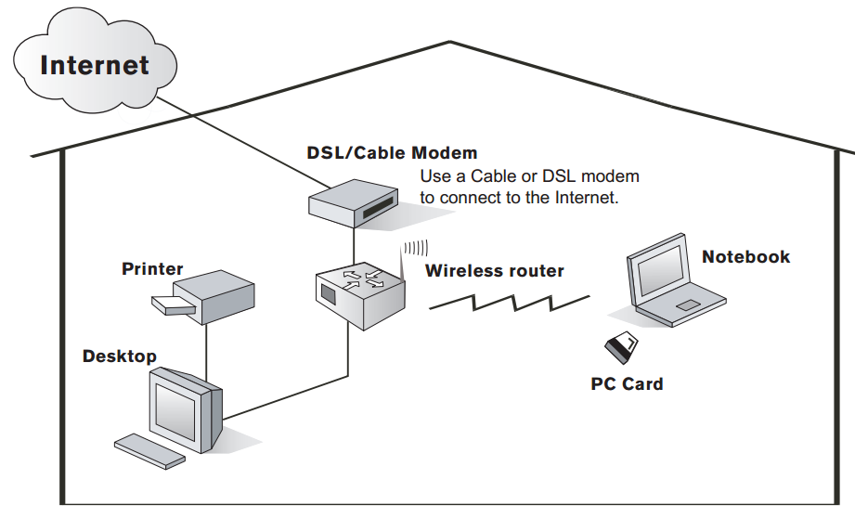
Design a network for a home
Hands-on Networking Fundamentals

Slide 24
Design a network for a home
Decisions You'll Need to Make
  Will your home network will be wired, wireless, or both?
  How many computers you will be connecting?
  Will you want to include printers, game consoles, or any other peripherals?
Hands-on Networking Fundamentals

Slide 25
Design a network for a home
Wired Networks:
Usually less expensive than wireless
Provides faster data transmission (up to 1,000MB/sec, but depends on the networking hardware)
Works across larger areas (not hampered by wireless limitations)
To network computers in different rooms or on different floors of your home, you will need to run cabling throughout the walls or along the baseboards
Wireless Networks:
Ability to set up computer anywhere, even go outside (within specified distance of home networking hardware)
Generally a quicker installation than wired (due to lack of wires and ease of installing laptop wireless networking cards)
Easy to expand your home network (just add computers and wireless adapters)
Hands-on Networking Fundamentals

Slide 26
Design a network for a home
1. The first thing to do is hook up the modem to the cable or
DSL connection in your wall.
2. Next, install the PC and/or PCI adapter cards in your
computers (if hooking up an older computer or setting up
a wireless home network).
3. Connect the modem and router (using a cable provided
by your ISP).
4. Connect each computer to the router either using cable,
or wireless adapter card. You may be required to insert
a CD and install the necessary network drivers.
What Will I Need?
  Modem
  Router or Gateway
  PC and PCI Cards
  Cable
  Installation CDs
  Home Networking Kits
Hands-on Networking Fundamentals

Slide 27
Q & A
http://fpt.edu.vn

